Slide 1
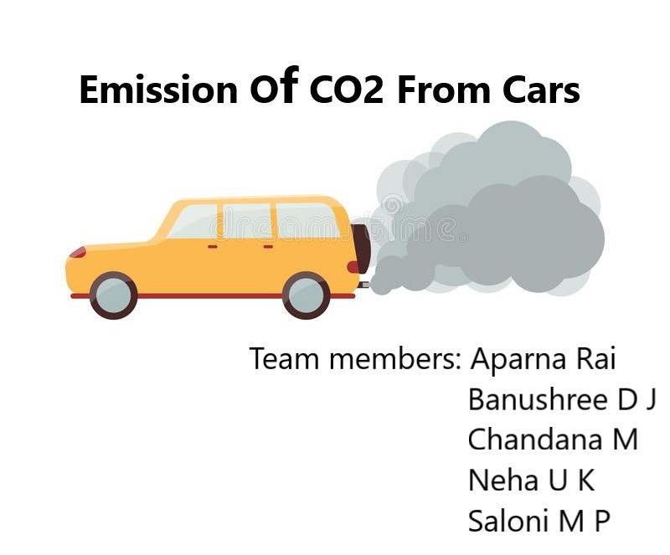

Slide 2
Introduction:
Machine learning is an application of artificial intelligence (AI) that provides systems the ability to automatically learn and improve from experience without being explicitly programmed
Carbon dioxide emissions or CO2 emissions are emissions stemming from the burning of fossil fuels and the manufacture of cement; they include carbon dioxide produced during consumption of solid, liquid, and gas fuels as well as gas flaring.
Here we use Machine Learning to predict CO2 emission of a car using its data. The model uses a handful of variables to predict the CO2 emissions of a car. The purpose of this model is to make accurate CO2 emission predictions given a few variables, using the random forest regression as the foundation.

Slide 3
Overview :
Nowadays, there are many factors affecting nature. Vehicle exhaust plays a major source of anthropogenic carbon dioxide (CO2) in metropolitan cities.
The number of vehicles emitting CO2 beyond a particular threshold should be seized by concerning RTA region head.
Here a new model for classifying pollutant level in automobile sector by using Machine Learning concepts. The model has been built using data form automobile sector to predict the status of CO2 emission.
One algorithms have been used to build the proposed model:-Random Forest.

Slide 4
LITERATURE SURVEY :
Existing Problem:
The amount of Co2 emission from the transport sector (including cars) accounts for about 20% of total CO2 emissions. Accordingly, from the viewpoint of preventing global warming, reducing that proportion is a key issue. In regard to CO2 emissions from cars, fuel economy standards are getting together all over the world, so improving fuel economy of cars is strongly desired.
Proposed Solution :
Machine Learning (Random Forest Regression):
Here in this project we are going to use random forest regression. By using this algorithm depends upon our input data the output of the vehicle are going to predict the CO2 emission of that particular car. So that if the emission of CO2 of that particular car is more than the threshold value then that car details should be sent to the particular RTA region head to seize the car.

Slide 5
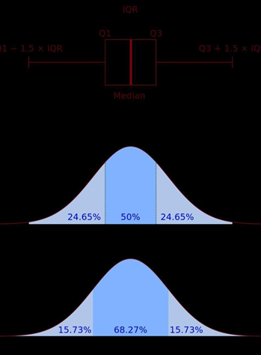
THEORETICAL ANALYSIS
The peculiarity of this problem is collecting the vehicles details in real time and working with the prediction at the same time, so we developed a user interface for the people who'll be accessing the emission of pollutants (CO2) status prediction.
The formula is as follows Accuracy = [IQR = Q3-Q1]
At first we calculated the Q1 and Q3 values respectively to calculate IQR (inter quartile range) value. This is also called as mid-spread, H-spread, is a measure of statistical dispersion being equal tothe difference between 75th and 25th percentiles, or between upper and lower quartiles

Slide 6
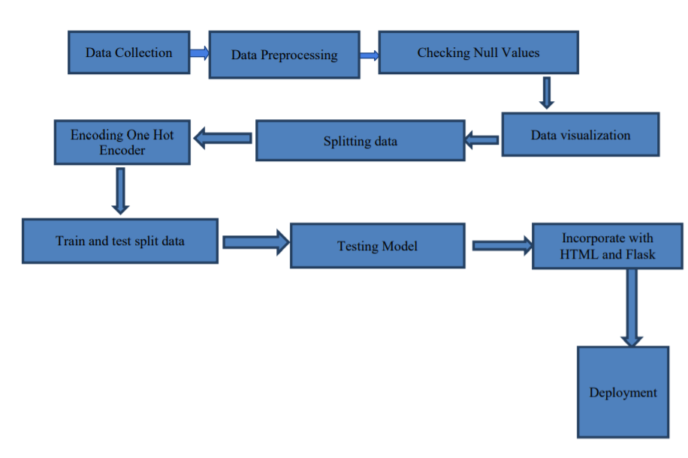
Block Diagram

Slide 7
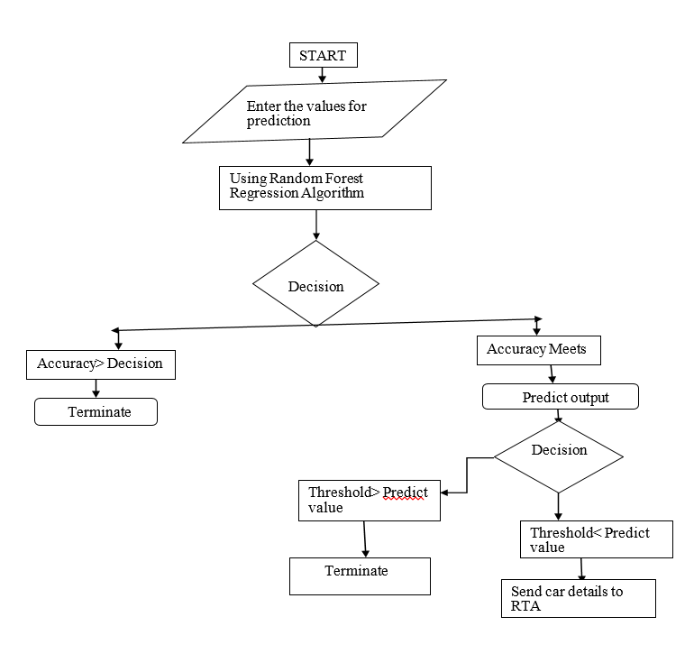
FLOWCHART

Slide 8
Software Designing
Jupyter Notebook Environment.
Spyder Ide.
Machine Learning Algorithms.
Python (pandas, numpy, matplotlib, seaborn, sklearn).
HTML.
Flask.

Slide 9
Software Designing Details :
We developed this emission of CO2 status prediction by using the Python language which is a interpreted and high level programming language and using the Machine Learning algorithms.
For coding we used the Jupyter Notebook environment of the Anaconda distributions and the Spyder, it is an integrated scientific programming in the python language.
For creating a user interface for the prediction we used the Flask. It is a micro web framework written in Python.
It is classified as a micro framework because it does not require particular tools or libraries. It has no database abstraction layer, form validation, or any other components where pre-existing third-party libraries provide common functions.
And we used a scripting language to create a webpage is HTML by creating the templates to use in the functions of the Flask and HTML.

Slide 10
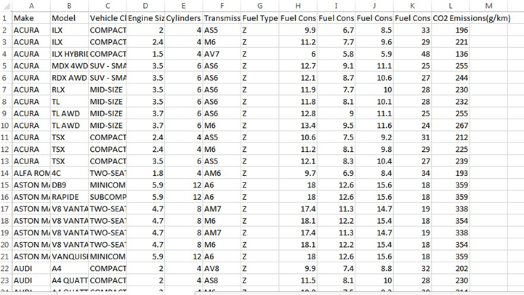
EXPERIMENTAL INVESTIGATION :
In this paper, the dataset we used is derived from https://www.kaggle.com/behrag/co2-emissionforecast-with-python-seasonal-arima/data.com.
It contains more than 7385 original data of users with 12 attributes. After that, the missing values are filled in by means of mode interpolation, and the duplicate or meaningless attributes are deleted, finally we have retained to 12 attributes.

Slide 11
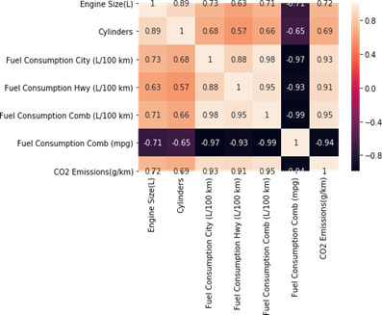
Result:
Heat map:
In this paper, the Random Forest algorithm is used to predict the vehicle performance with respect to CO2 emission from cars. The obtained results are displayed in Table below. The results shows that, the performance of vehicles on the basis of emission of CO2 is displayed as well as the accuracy on predicting the defaulters are mentioned in it respectively.
Algorithm Used | Accuracy
Random Forest Regression | 98%

Slide 12
Advantages Of This Model :
Easy and simple User Interface for the people who is going to evaluate the vehicle’s pollution emission’s status.
Random Forest Regression give the accurate result of the prediction up to 98% which is the algorithm we used for prediction.
It is widely used for managing risks in the transportation sector.
It can work in real time and predict as soon as the necessary details for prediction are given to the model.

Slide 13
Disadvantage Of This Model :
Gives 98% accuracy for the prediction status leading to over fitting of data.
It could not work anywhere like a web-application, if one is using other should be static.
Needs multiple value for the prediction.

Slide 14
APPLICATIONS :
It is widely used for managing risks in the transportation and ecological sector. Government as well as RTA officials need to know the credibility of customers they are dealing with in real time.
To have an idea of customer relationship cycle such as customer acquisition, increasing value of the customer and customer retention and standards of vehicle hybridization.
Due to tremendous growth in data this industry deals with, analysis and transformation of the data into useful knowledge has become a task beyond human ability.
So we use Machine Learning Algorithms to analyze the data and propose what transportation sector companies need to achieve their needs.

Slide 15
Future Scope
The scope of Machine Learning is not limited to the transport sector. Rather, it is expanding across all fields such as banking and finance, information technology, media & entertainment, gaming, and the automotive industry.
Furthermost, Random forest regression algorithm can be applied on other datasets available for co2 emission to further investigate its accuracy.
In further studies, we will try to conduct experiments on larger datasets or try to tune the model so as to achieve the state of-art performance of the model.

Slide 16
Conclusion :
In this paper, the Random Forest algorithm is adopted to build a UI model for predicting pollutants default in the lending sector and the results are stored in the database.
The Experiment shows that the algorithm performs outstanding than the data mining algorithms in the prediction of defaulters and has strong ability of generalization.
There is no definitive guide of which algorithms to use given any situation. What may work on some data sets may not necessarily work on others.
Therefore, always evaluate methods using cross validation to get a reliable estimates.

Slide 17
THANK YOU

